Slide 1
CTAI PRESENTATION
Shubham Kaushik
2301418F [T03]

Slide 2
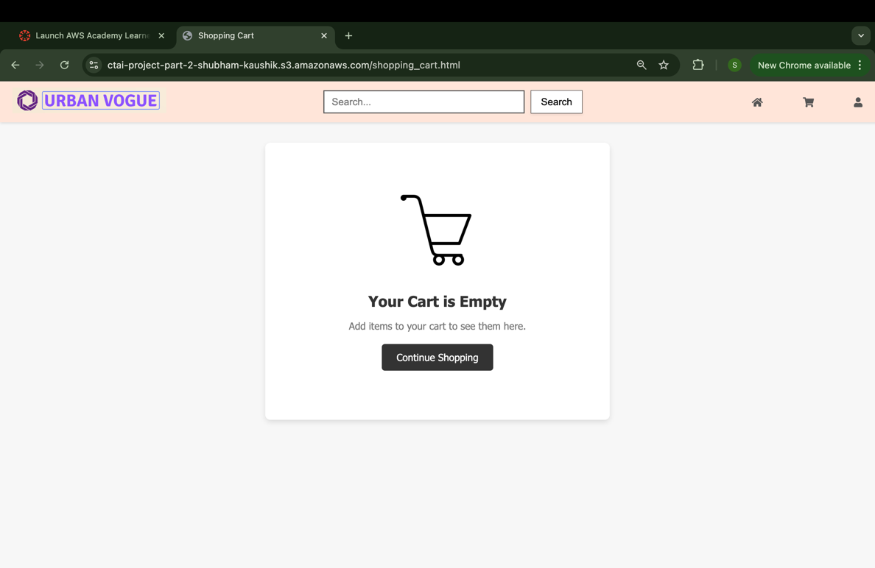
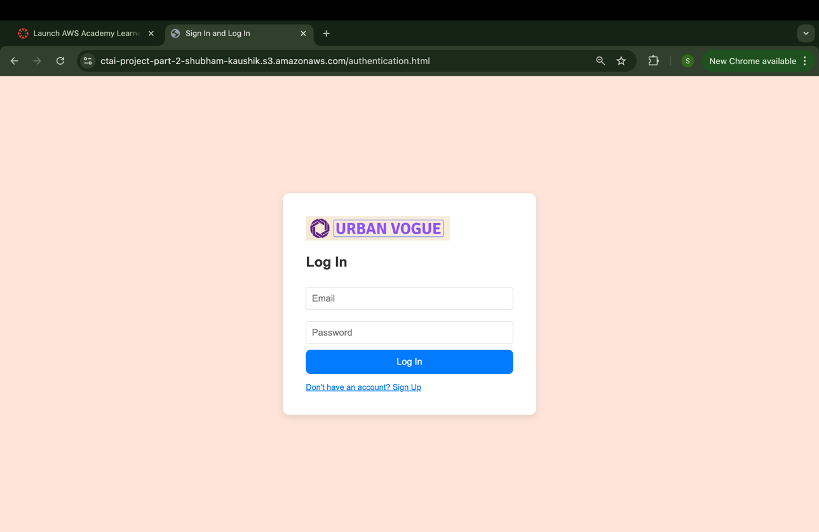
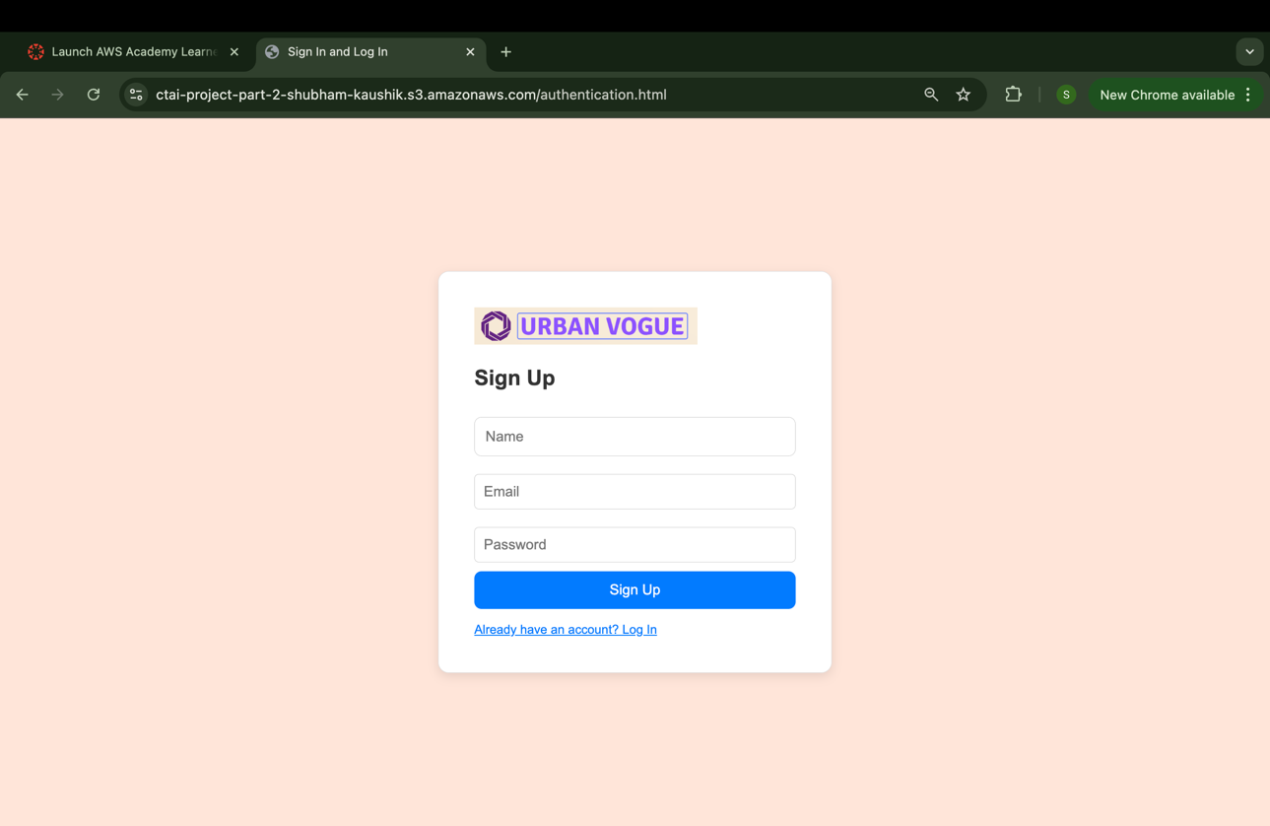
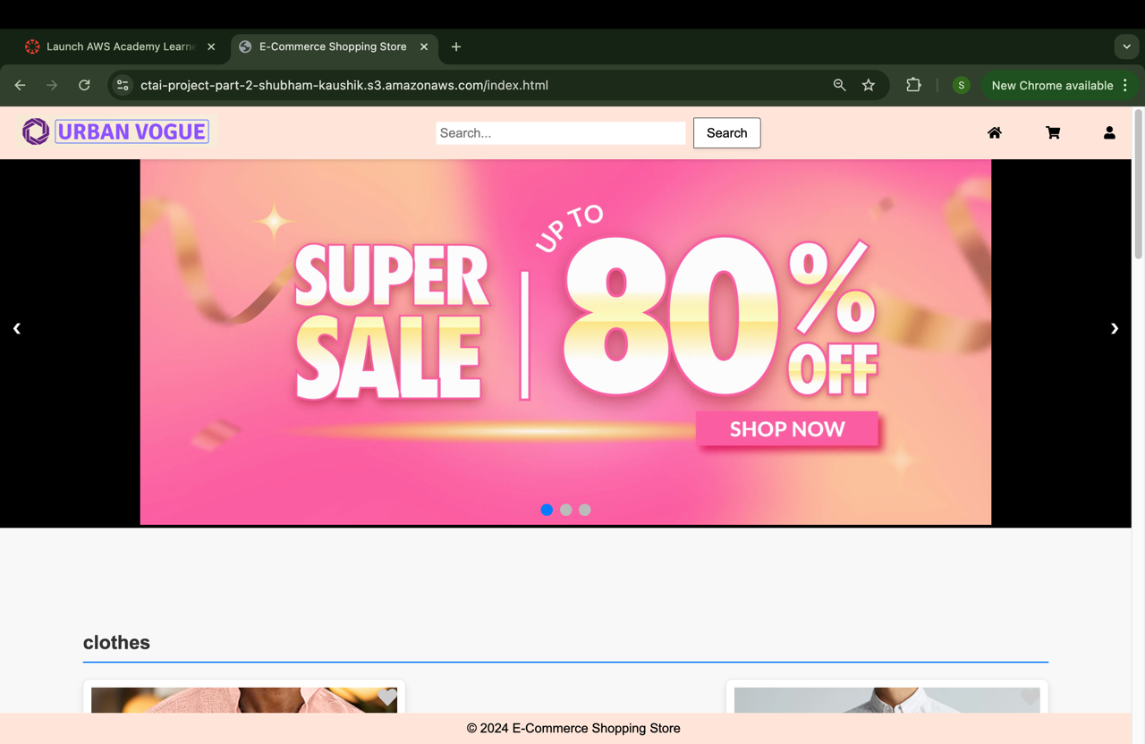
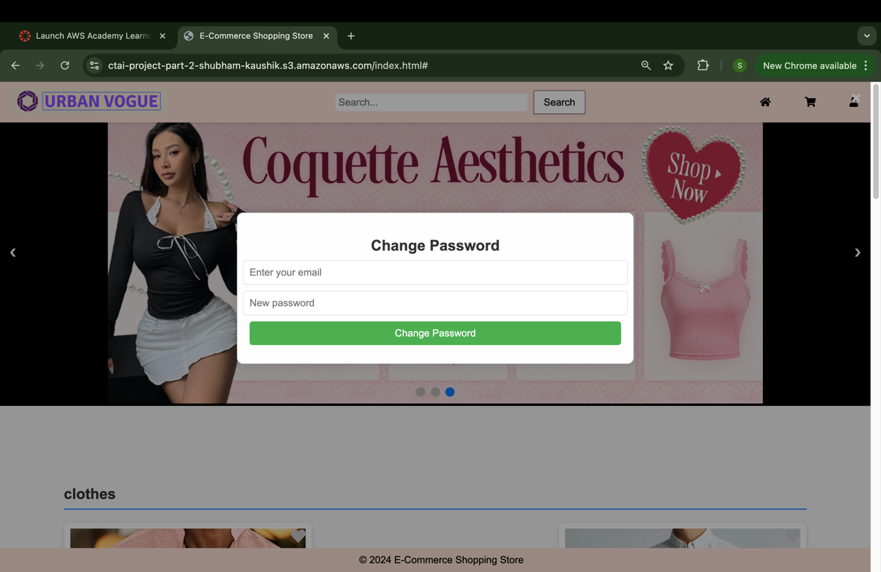
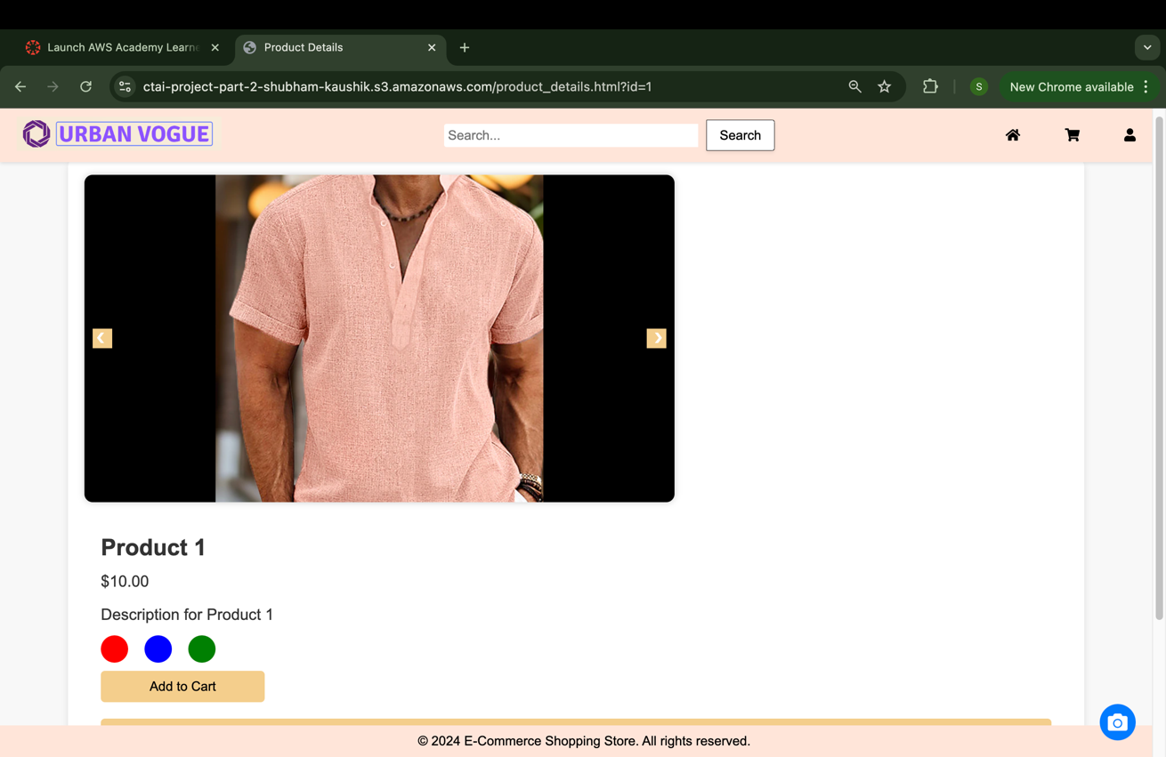
Overview of website
Product Page
Change Password
Log In
Shopping Cart
Home Page
Sign Up

Slide 3
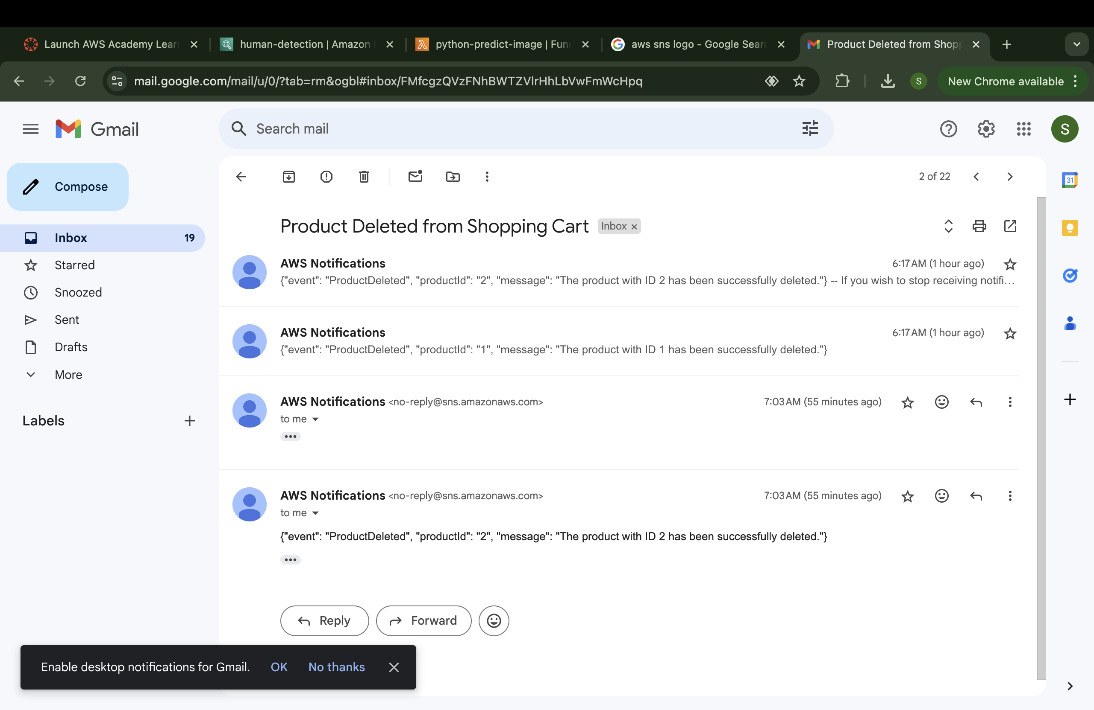
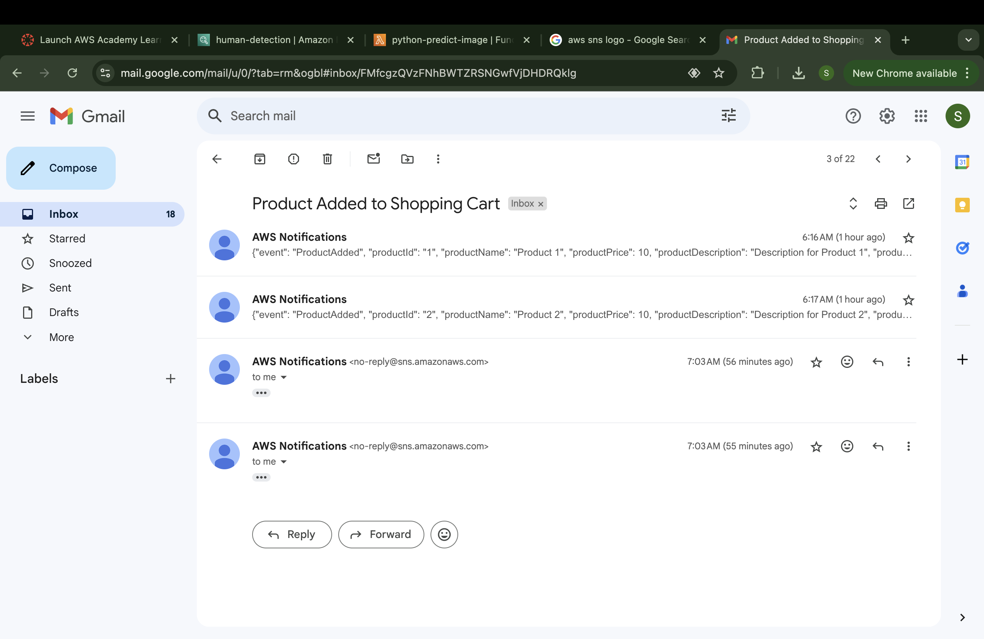
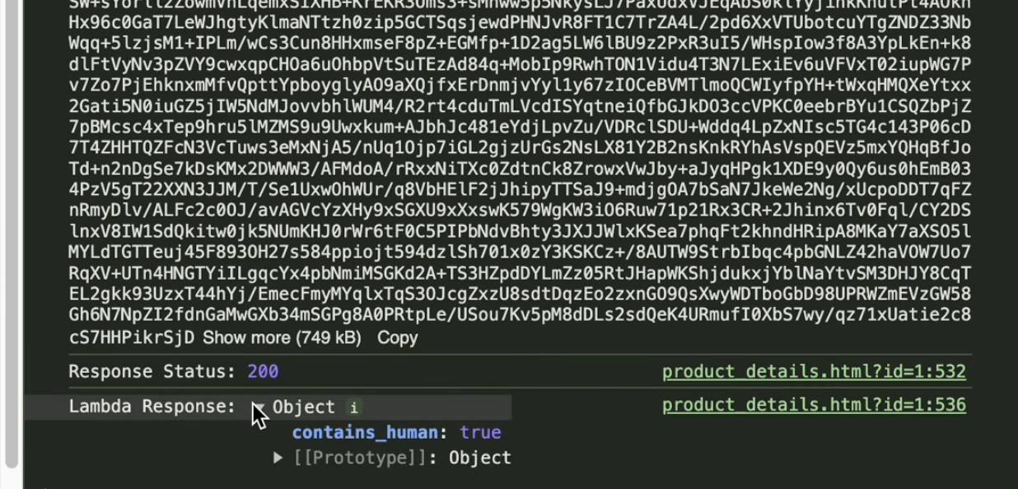
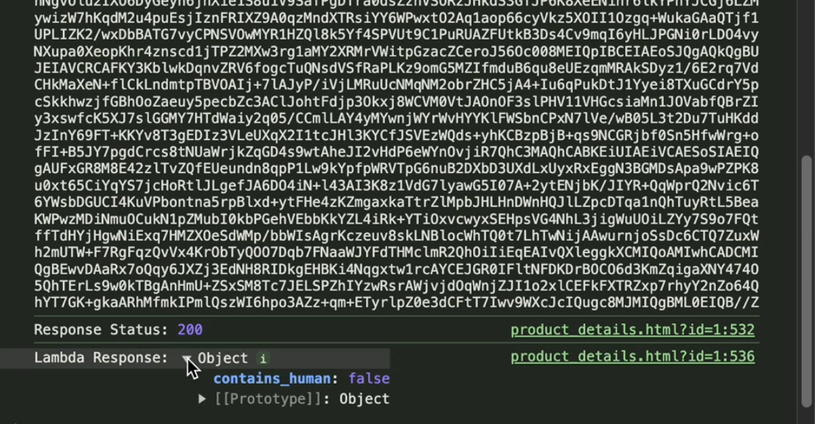
Overview of website
Email Notification [Deleted Product]
Email Notification [Added Product]
AWS Rekognition Outcome [Image contains human]:
AWS Rekognition Outcome [Image contains dog]:

Slide 4
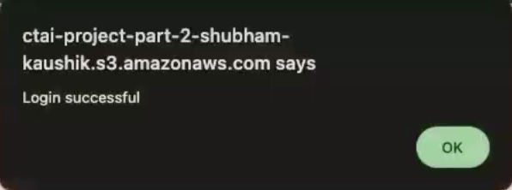
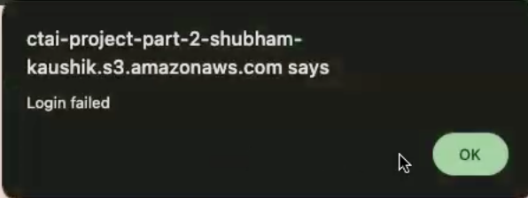
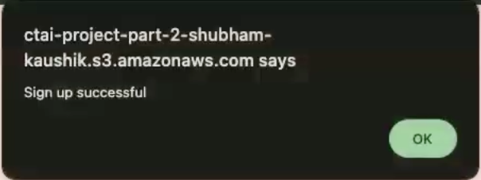
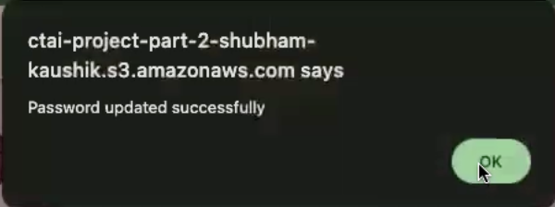

Successful Log In
Unsuccessful Log In
Successful Sign Up
Successful Changed Password
Successful Uploaded Image

Slide 5
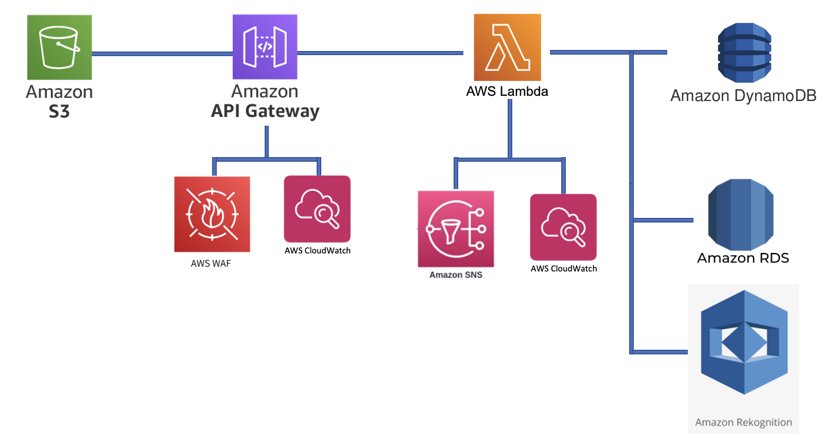
Breakdown of services used
AWS Architecture Diagram

Slide 6

Breakdown of services used
AWS S3
AWS S3 was used for;
Website Hosting
S3 was used as the primary storage for hosting my website, ensuring high availability and scalability.
Retrieving data of products
Product data, including images, names, prices, and other details, were stored in S3. This data was dynamically retrieved and displayed on the Home Page and Product Page, ensuring a seamless user experience.
Retrieve image uploaded by used for AWS Rekognition to scan
Images uploaded by users were stored in S3 and then retrieved for analysis using AWS Rekognition. This integration allowed AWS Rekognition to scan and process images efficiently, leveraging S3’s secure storage and powerful image analysis capabilities of Rekognition.

Slide 7
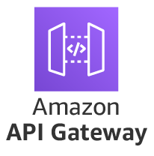
AWS API Gateway
AWS API Gateway had;
RESTful API Management
RESTful API was used to Create, Deploy, and manage RESTful APIs using HTTP Methods such as; POST, PUT, GET & DELETE.
Served as the interface between client applications and backend services
Security & Protection
AWS API Gateway was integrated with AWS WAF
Monitoring & Logging
AWS API Gateway was integrated with AWS CloudWatch.
Enabling real-time monitoring and troubleshooting of API Performance & errors.

Slide 8

AWS API Lambda
AWS Lambda had;
Event-Driven Processing & Notifications
One Lambda function [‘website-cart-project-b’] was integrated with AWS SNS & AWS RDS.
HTTP Methods used: GET, POST, DELETE
Automated Image Analysis
Another Lambda function [‘python-predict-image’] was integrated with AWS Rekognition.
HTTP Methods used: POST
Real-time management/Authenticate
Another lambda function [‘Authentication’] was integrated with AWS DynamoDB.
HTTP Methods used: PUT, POST

Slide 9

AWS WAF
AWS WAF was implemented on AWS API Gateway. This implementation enhanced the security of our web application by filtering and monitoring incoming.
Rules implemented;
Anonymous IP Blocking:
Reputation-Based Filtering:
Bad Input Detection:
Protection Against Linux Exploits:
Efficient Rule Management

Slide 10

AWS SNS
AWS SNS was implemented on AWS Lambda Function [‘website-cart-project-b’.]
AWS SNS has;
Real-Time Notifications:
AWS SNS was integrated with Lambda & RDS:
AWS SNS was integrated with a Lambda function named ‘website-cart-project-b’ which was responsible for processing user actions on the website, specifically when items were added to the cart.
Automated Email Alerts:
Email Notification:
AWS SNS was configured to automatically send an email whenever the website-cart-project-b Lambda function was triggered by an API call

Slide 11
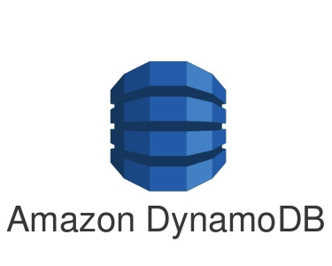
AWS DynamoDB
AWS DynamoDB was implemented on AWS Lambda Function ‘Authentication’.
AWS DynamoDB has;
Real-Time Data Management:
Integration with Lambda[‘Authentication’]:
The ‘Authentication’ lambda function is connected to DynamoDB to manage user-related data.
The function performs operations such as reading, writing, and updating user information stored in DynamoDB tables. The tables contained critical data like usernames, passwords, and email addresses
User Authentication:
Handling Login & Password Management/Update:
When a user attempts to log in the lambda function ‘Authentication ’ queries the DynamoDB table to check the provided username & password against the stored data.

Slide 12

AWS RDS
AWS RDS was implemented on AWS Lambda Function allowing the client side to handle
structured data storage and management.
AWS RDS has;
Structured Data Storage:
Integration with Lambda[‘website-project-part-b’ function]:
The website-cart-project-b Lambda function was connected to AWS RDS to manage and store data related to user activities on the website, specifically, items added to the shopping cart.
Data Persistence and Retrieval:
Shopping Cart Data:
AWS RDS was used to persistently store the cart information, including details like product IDs, quantities, and user identifiers.
Querying & Updating:
The Lambda function also utilized RDS to query existing cart data (e.g., when a user wanted to view their cart) and update records as users added, removed, or modified items in their cart.
This real-time interaction ensured that the cart was always up-to-date and reflected the user’s latest actions.

Slide 13
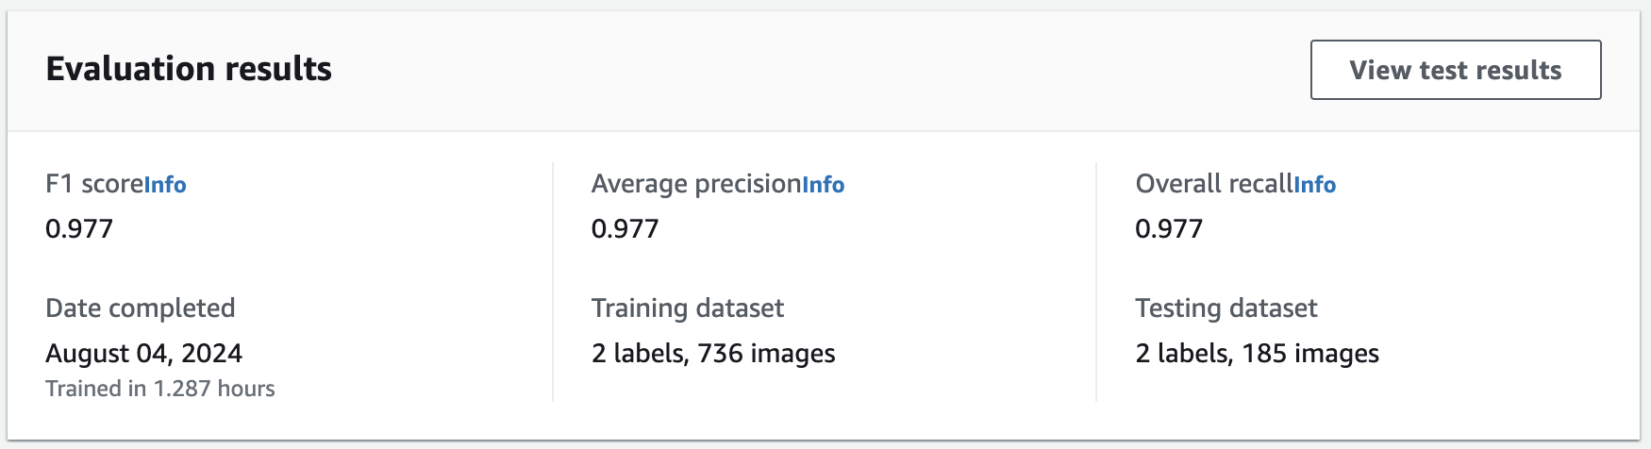

AWS Rekognition
AWS Rekognition was implemented as the core image analysis service in our project, providing powerful image and video recognition capabilities.
AWS Rekognition has;
Automated Image Analysis:
Integration with Lambda (python-predict-image):
The python-predict-image Lambda function was connected to AWS Rekognition to perform automated image analysis.
When a user uploads an image through the website, this function is triggered to process the image by sending it to AWS Rekognition for analysis.
Human Detection:
Verifying Image Content:
The primary purpose of the python-predict-image Lambda function was to check whether the uploaded image contained human figures.
AWS Rekognition provided the tools to analyze the image and return a result (true/false) indicating the presence of humans.

Slide 14
Challenges faced
CORS Errors:
Challenge: CORS errors occur when a web application hosted on one domain tries to request a server on a different domain, and the server does not include the appropriate headers to allow this interaction
Enable CORS in API Gateway [Solution]:
I ensured that CORS is properly configured in API Gateway.
This involved setting up the appropriate Access-Control-Allow-Origin, Access-Control-Allow-Methods, and Access-Control-Allow-Headers headers in my API Gateway settings.

Slide 15
Challenges faced
2. Data Consistency Issues:
Challenge: DynamoDB operates on an eventual consistency model by default, which can lead to issues where the most recent updates are not immediately reflected in queries.
Used Strongly Consistent Reads [Solution]:
I configured DynamoDB to use strongly consistent reads, which ensure that the most recent data is always returned. Set the ‘ConsistentRead’ parameter to ‘true’
3. JSON Formatting Issues:
Challenges that I faced were;
Incorrect Request Handling
Response Structure Issues
Solution:
Mapping Templates
Lambda Proxy Integration
Validating JSON Response
Testing and Debugging

Slide 16
Potential enhancements
VPC Integration for Lambda Functions: Enhance security by configuring Lambda functions to run within a Virtual Private Cloud (VPC), providing network-level isolation and control.
Implement AWS IAM for Access Management: Utilize AWS Identity and Access Management (IAM) to define and manage permissions securely for different AWS services, ensuring that only authorized entities have access to critical resources.
Data Encryption with AWS KMS: Implement data encryption for RDS using AWS Key Management Service (KMS) to protect sensitive user data both at rest and in transit, ensuring compliance with security best practices.

Slide 17
Video Link
YouTube Link:
https://youtu.be/Exv38-ixGjY

